Slide 1
Microprocessors and Assembly Language Lecture 1 Hamed Farbeh farbeh@aut.ac.ir Fall 2024

Slide 2
Course Description

Slide 3

Grading
Final Exam: 40%
Midterm Exam : 30%
Homework: 10%
Project: 10%
Quizzes: 10%
AND
Lab

Slide 4
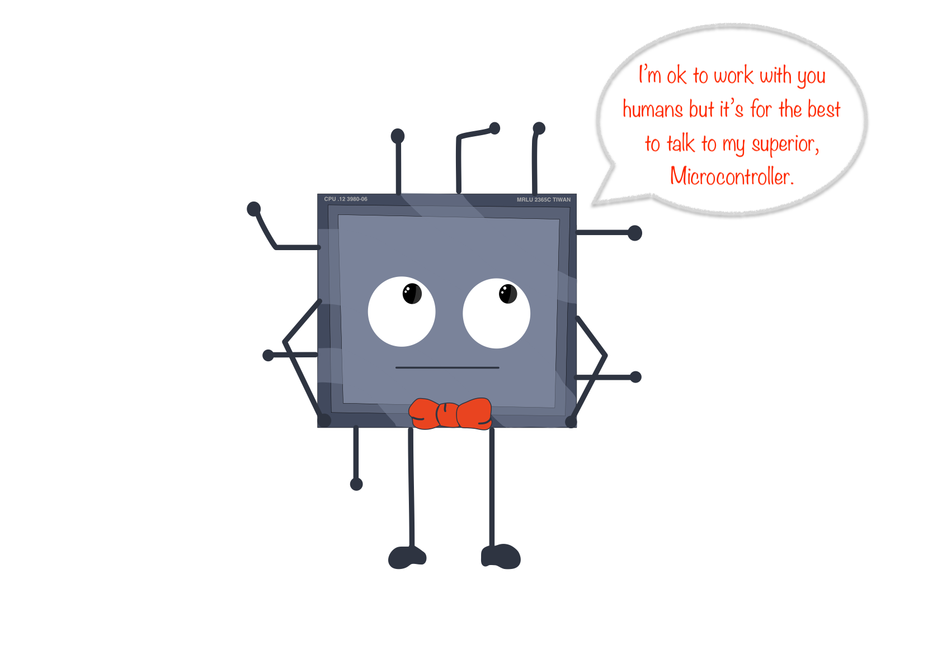
Course Outline
Microprocessors and Microcontrollers
How they work
AND
How to work with them
Telegram channel: t.me/micro_fall2024

Slide 5
References
Main
Arm Assembly Language Programming and Architecture, Volume 1, 1st edition, Muhammad Ali Mazidi, Sarmad Naimi, and Sepehr Naimi, MicroDigitalEd, 2013
Atmel | SMART ARM-based MCU DATASHEET, SAM3X / SAM3A Series, Atmel-11057C-ATARM-SAM3X-SAM3A-Datasheet_23-Mar-15
ARMv7-M Architecture Reference Manual
Complementary material
ARM Assembly Language: Fundamentals and Techniques, 2nd Ed., William Hohl, Christopher Hinds, CRC Press, 2014.
Modern Assembly Language Programming with the ARM Processor, Larry D. Pyeatt, Elsevier, 2016.
Embedded Systems:Introduction to ARM®CORTEX-M Microcontrollers, Vol. 1, 5th Ed., Jonathan W. Valvano, 2014.

Slide 6
Copyright Notice
Parts (text & figures) of this lecture are adopted from:
Arm Assembly Language Programming and Architecture, Volume 1, 1st edition, Muhammad Ali Mazidi, Sarmad Naimi, and Sepehr Naimi, MicroDigitalEd, 2013
Design of Microprocessor-Based Systems (AKA Embeded Systems Design and Implementation), Prabal Dutta, University of Michigan
Cortex™-M3 Revision r2p1 Technical Reference Manual
ARMv7-M Architecture Reference Manual

Slide 7
Computer History

Slide 8
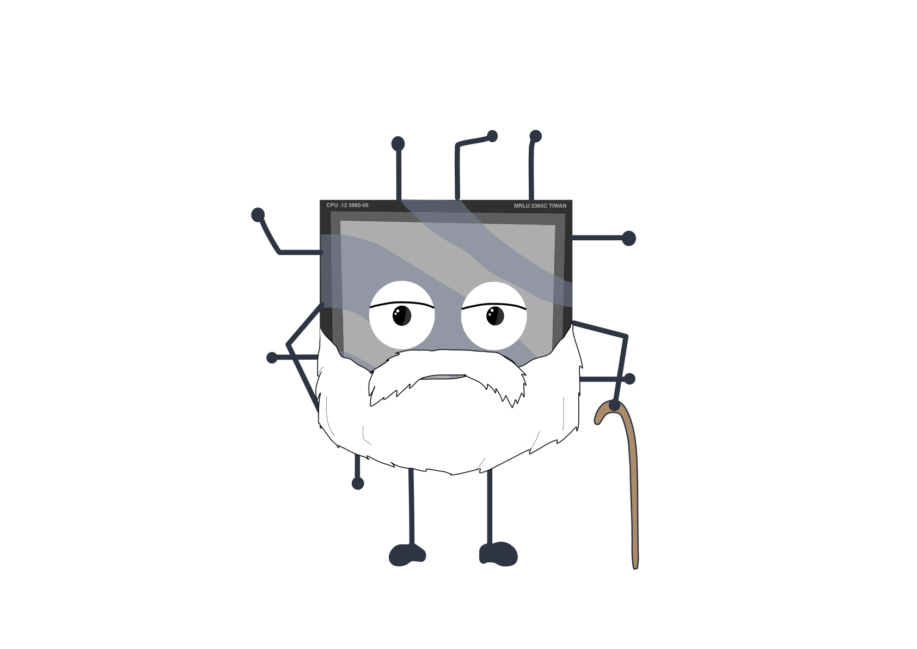
Computer History
Mechanical Computers (19th century)
Electro-Mechanical Computers (1936)
Electronic Computers (1941)

Slide 9
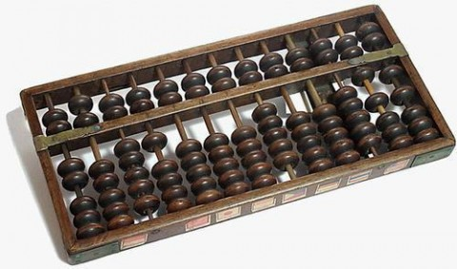
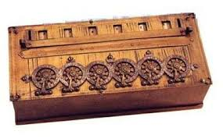
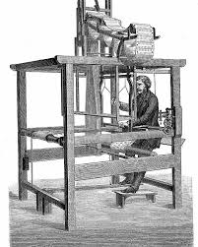
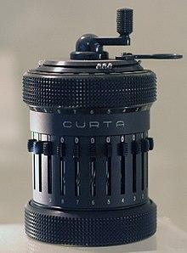
Computer History
Mechanical Computers
Abacus
Mechanical calculators
Pascal’s calculator (1642)
Curta (1930s)
Punched-card data processing (1725, 1800s, 1900s)

Slide 10
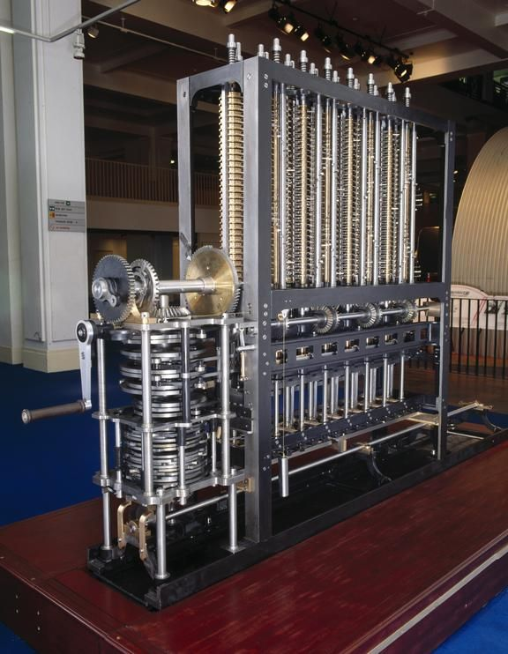
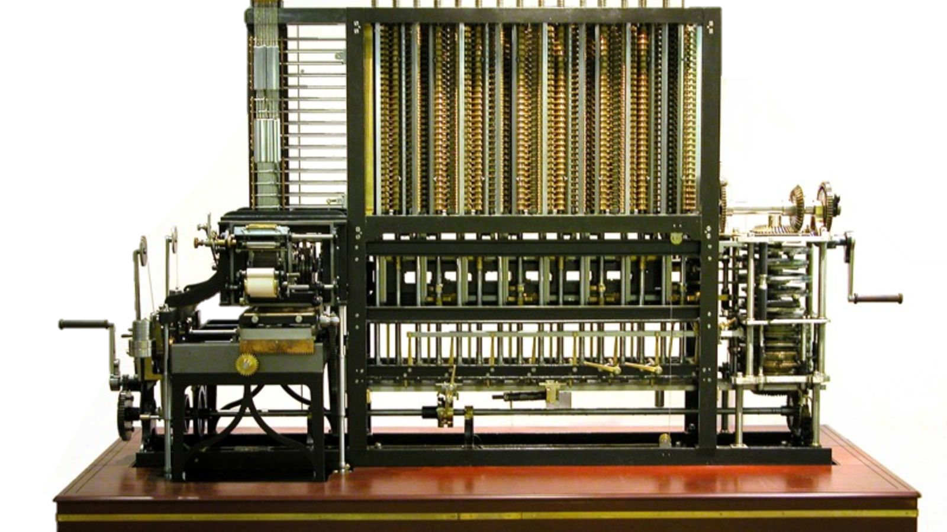
Computer History
Mechanical Computers
Difference engine: Charles Babbage (1791-1871)
First general-purpose computing device
Analytical engine

Slide 11
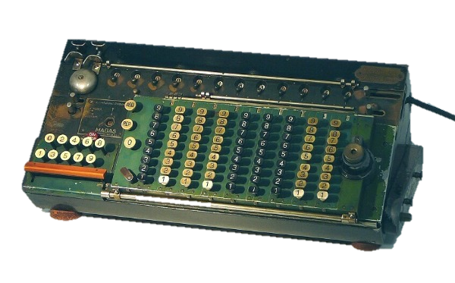
Computer History
Electro-Mechanical Computers
Switches, relays
Early 1900s
Zuse’s Z2, Z3, Z4
(world's first commercial digital computer, mechanical memory)

Slide 12
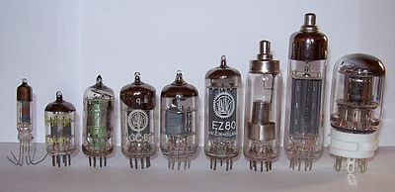
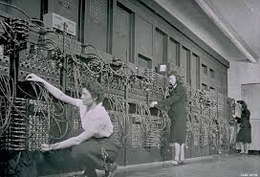
Computer History
Electronic Computers
1st generation
vacuum tubes (1945-1955)
ENIAC, 1946

Slide 13
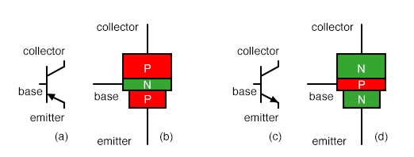
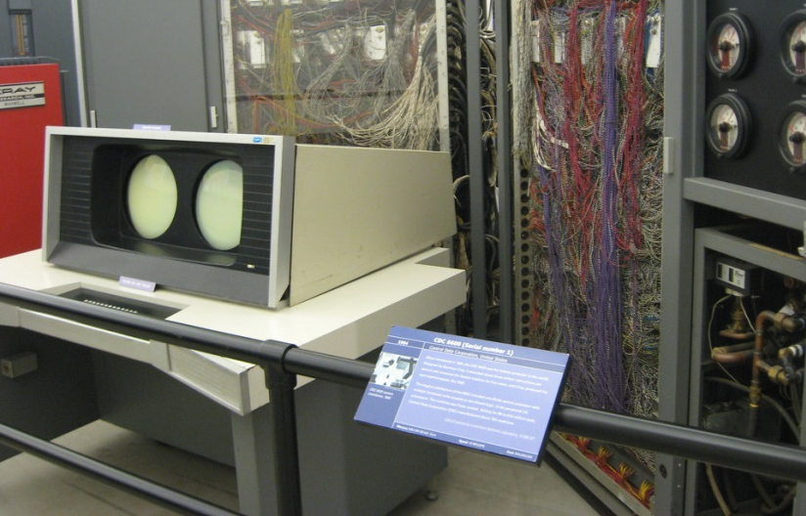

Computer History
Electronic Computers
2nd generation
BJT transistors (1955-1965)
CDC 6600 (1964-1969)
world's fastest computer from 1964 to 1969
$2,370,000
30kW, 6tons
10MHz, 2 MIPS
Up to 982 kilobytes

Slide 14
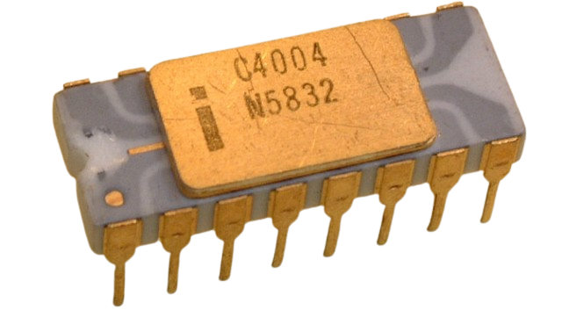
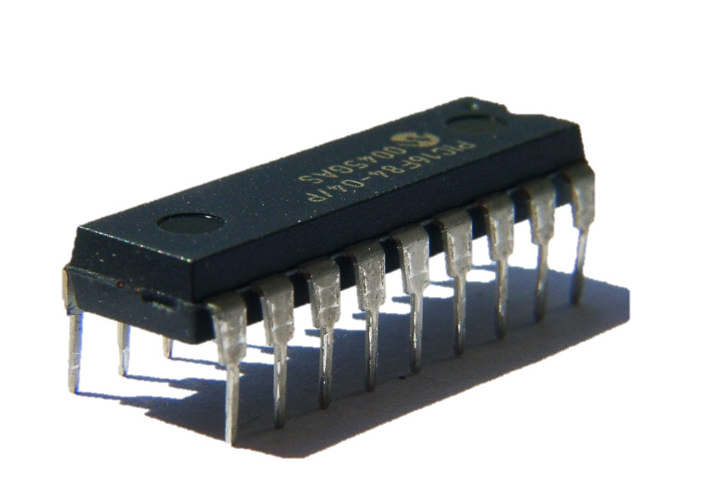
Computer History
Electronic Computers
3rd generation
integrated circuits (1965-1974)
Intel 4004 (1971)
The first commercially available microprocessor
10 µm process
92,000 instructions per second
1 MHz clock rate
Major improvement of today's computers → better ICs.

Slide 15
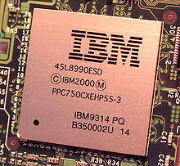
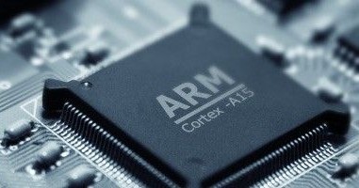
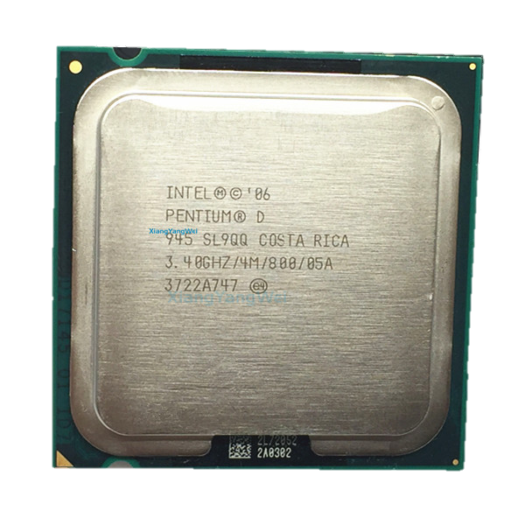
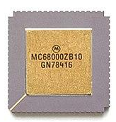
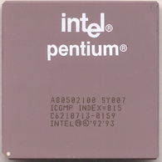
Computer History
Electronic Computers
4th generation
1974-1989
5th generation: ULSI
1990-present

Slide 16
A brief recap of the computer history
Year | Technology Used in Computers | Relative Performance per unit cost
~1950 | Vacuum tube | 1
1960s | Transistor | 35
1975 | Integrated circuit | 900
1995 | Very large scale integrated circuit | 2,400,000
2005 | Ultra large scale integrated circuit | 6,200,000,000

Slide 17
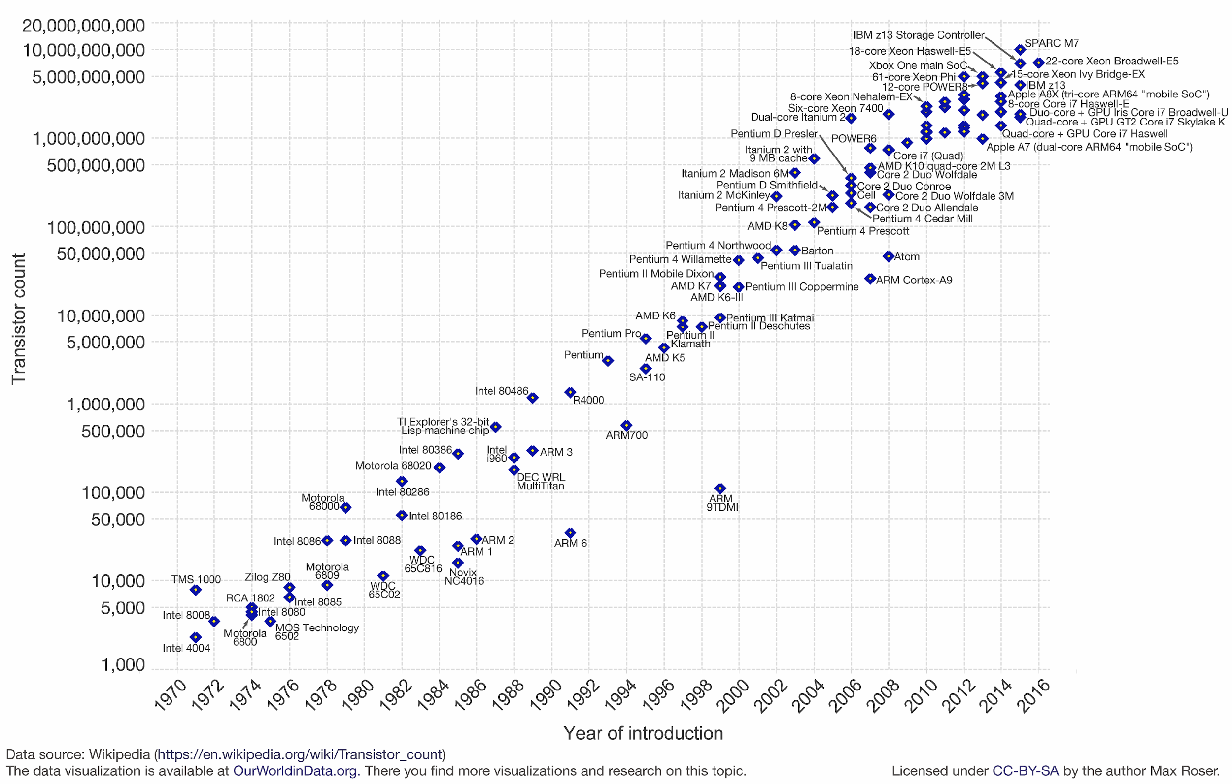
Computer History
What happened from 1970?
Transistor count doubles every 24-month

Slide 18
Instruction Set Architecture (ISA)

Slide 19

Instruction Set Architecture (ISA)
A set of instructions used by a machine to run programs
Interface between hardware & software
Computer language vocabulary
Provides an abstraction of hardware implementation
Hardware implementation decides what and how
instructions are implemented
ISA specifies
Instructions, Registers,
Memory access, Input/output
Applications
Compilers
Operating System
Architecture (ISA)
Microarchitecture
Digital Design
Circuit
Device
Layers of abstraction in the computer architecture

Slide 20
Instruction Set Architecture (ISA)
How many instructions are needed?
What functionalities are required?
Load/store
Control
Arithmetic/logic

Slide 21
Instruction Set Architecture (ISA)
Key ISA decisions
Instruction length
Number, length, and types of registers
Where operands reside
How to access memory
Instruction format
Operand format: How many and how big

Slide 22
Instruction Set Architecture (ISA)
Instruction length
Variable:
x86 – Instructions vary from 1 to 17 Bytes long
VAX – from 1 to 54 Bytes
Fixed:
MIPS, PowerPC, ARM:
all instruction are 4 Bytes long

Slide 23
ISA: Instruction length
Variable-length instructions | Fixed-length instructions
Require multi-step fetch and decode | Allow easy fetch and decode
Allow for a more flexible and compact instruction set | Simplify pipelining and parallelism
CISC processors like x86 & VAX Complex Instruction Set Computing | RISC processors like MIPS & PowerPC Reduced Instruction Set Computing

Slide 24
ISA: RISC vs. CISC
Early Trend
Adding more instructions to next generation CPUs to do more complicated operations
VAX arch had an instruction to multiply polynomials!
CISC Philosophy
Limited main memory + immature compilers
More dense instructions, highly encoded, variable length instructions
Data loading as well as calculation

Slide 25
ISA: RISC vs. CISC
RISC Philosophy
Keep ISA small and simple
Makes it easier to build faster hardware
Let SW do complicated operations by composing simpler instructions
Note on “Reduced" in RISC Phrase
Amount of work any single instruction accomplishes reduced
Single ALU operation, single memory access, …

Slide 26
ISA: RISC vs. CISC
CISC Problems
Performance tuning challenging
Complex/high-level instructions rarely used
Slower clock rates
Longer time-to-market
Due to prolonged design time
CISC Features
Ease compiler implementation
HW supports all kind of addressing modes

Slide 27
ISA: RISC vs. CISC
RISC Features
Low complexity
Less error-prone HW implementation
Implementation advantages
Less transistors
Extra space: more registers, cache
Marketing
Reduced design time

Slide 28
ISA: RISC vs. CISC
RISC vs. CISC
Hangul vs. Hiragana

Slide 29
ISA: How many registers?
Advantages of a small number of registers
Requires fewer bits to specify which one
Less hardware
Faster access
Shorter wires
Faster index decoding (fewer logic levels)
Faster context switch (your OS course!)
When all registers need saving
Faster access

Slide 30
ISA: How many registers?
Advantages of a larger number of registers
Fewer loads and stores needed
Due to Less data transfer between CPU & memory
Easier to do several operations at once

Slide 31
ISA: Where do operands reside?
Stack Machine
Generally outdated
Accumulator Machine
Register-Memory Machine
Nowadays, computers are mainly from this category(Intel x86, Intel x64)
Load-Store Machine
aka Register-Register Machine

Slide 32
ISA: Where do operands reside?
Code sequence for C = A + B
Stack
1. Push A
2. Push B
3. Add
4. Pop C
Accumulator
1. Load A
2. Add B
3. Store C
Register-Memory
1. Add C, A, B
Load-Store
1. Load R1, A
2. Load R2, B
3. Add R3, R1, R2
4. Store C, R3

Slide 33
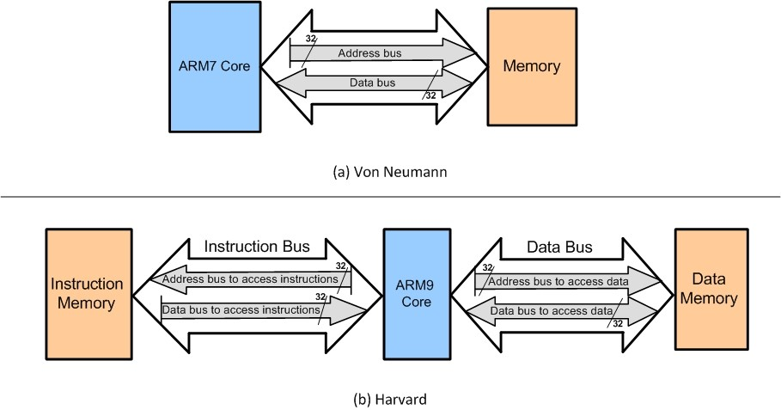
Harvard vs. Von Neumann

Slide 34
Types of Computer Systems

Slide 35
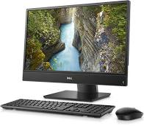
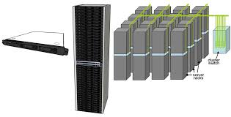
Types of Computer Systems
Desktops
General purpose
Market dominated by x86 processors
Various software
For use by individuals
Servers and Warehouse-Scale Computers (WSCs)
Thousands of cores and disks
Market dominated by x86-compatible server chips
Dedicated apps, plus cloud hosting of virtual machines
Increasing use of GPUs, FPGAs, and custom hardware to accelerate workloads

Slide 36
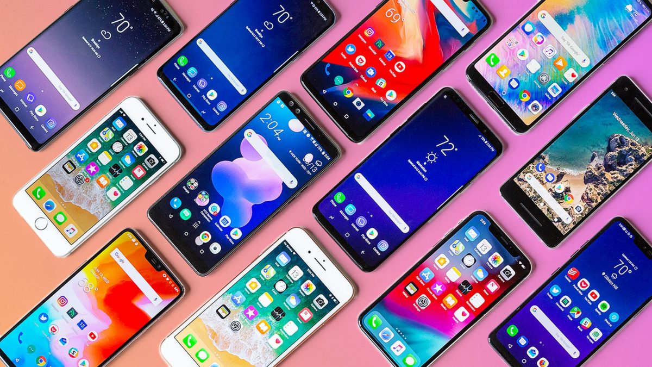
Types of Computer Systems
Mobile (smartphone/tablet)
>1 billion sold/year
Market dominated by ARM-ISA-compatible general-purpose processor in system-on-a-chip (SoC)
Plus sea of custom accelerators (radio, image, video, graphics, audio, motion, location, security, etc.)
Anything Else?

Slide 37
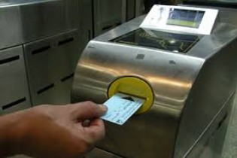
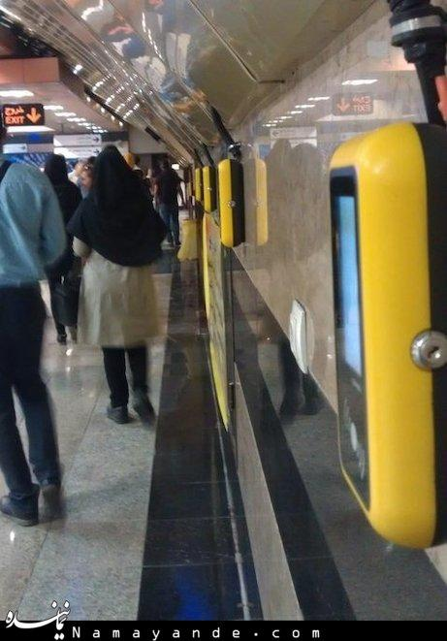
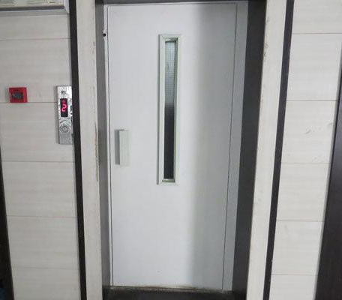
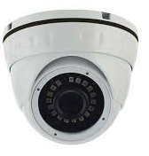
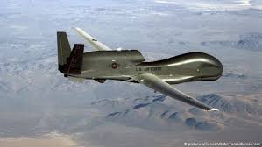

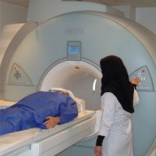
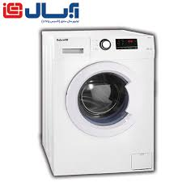
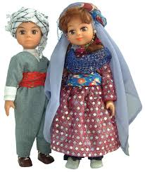
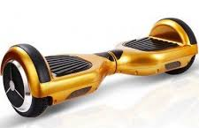
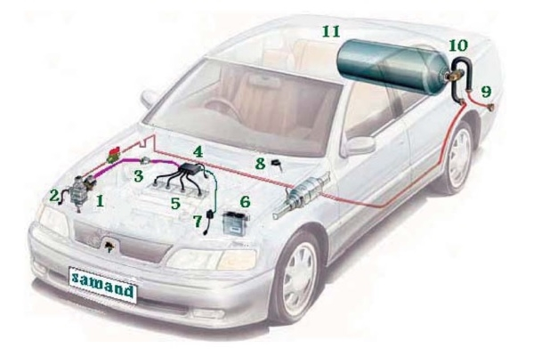
Types of Computer Systems
Embedded Systems

Slide 38
Computer System Design Criteria
Implementation cost Time to market Maintainability Debugging Flexibility Scalability … | Performance Power consumption Energy consumption Area Weight Design cost

Slide 39
Options for Building Embedded Systems
Dedicated hardware
ASIC (Application-specific integrated circuit)
Hard to implement a dedicated hardware from scratch
There is only a limited number of hardware producers
Programmable logic (FPGA, PLD)
-> Both methods are costly and complicated
Software running on generic hardware
Microprocessor + memory + peripherals
Microcontroller (internal memory & peripherals)
A combination of all options (Complex systems)

Slide 40
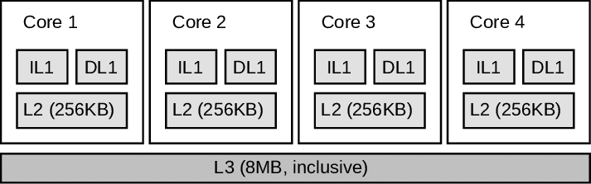
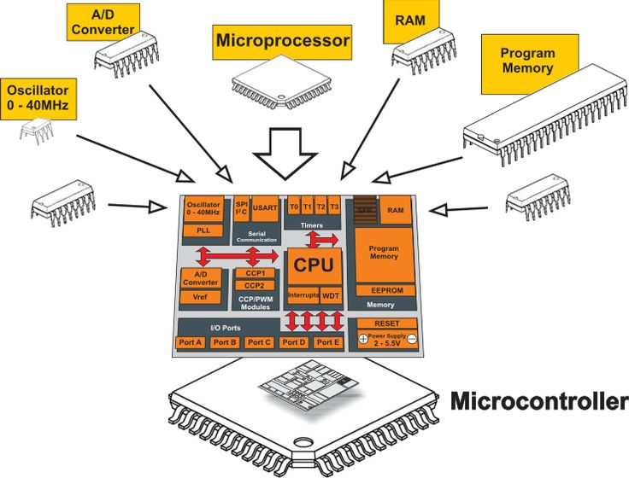
Microprocessor vs. Microcontroller
Microprocessor
An IC that has only CPUs inside it
No RAM, ROM, or other peripheral
Microcontroller (MCU)

Slide 41
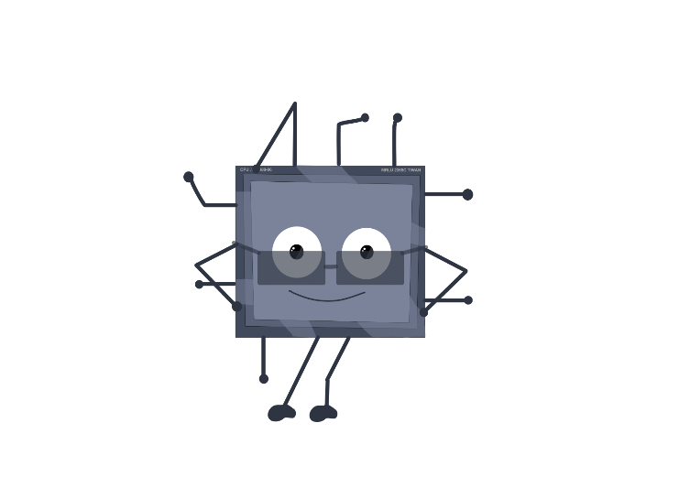
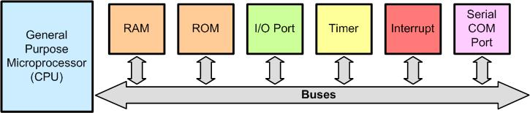
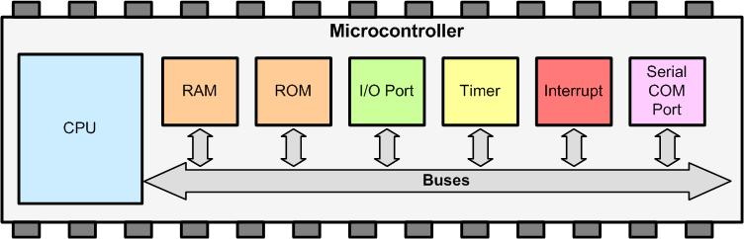
Microprocessor vs. Microcontroller
Microprocessor
Microcontroller (MCU)

Slide 42
Microprocessor vs. Microcontroller
Microprocessor | Microcontroller
Heart of computer systems | Heart of embedded systems
It is just a processor. Memory and I/O components are connected externally | Has processor along with internal memory and I/O components
Since memory and I/O have to be connected externally, the circuit becomes larger | Since memory and I/O have to be connected externally, the circuit is small
Cannot be used in compact system | It is efficient for compact systems
The entire energy consumption is high due to external components | Suitable for battery-operated systems
Slow memory access | Fast memory access
Is based on Von Neumann architecture (program and data are stored in the same memory module) | Is based on Harvard architecture (program and data memory are separate)

